Slide 1
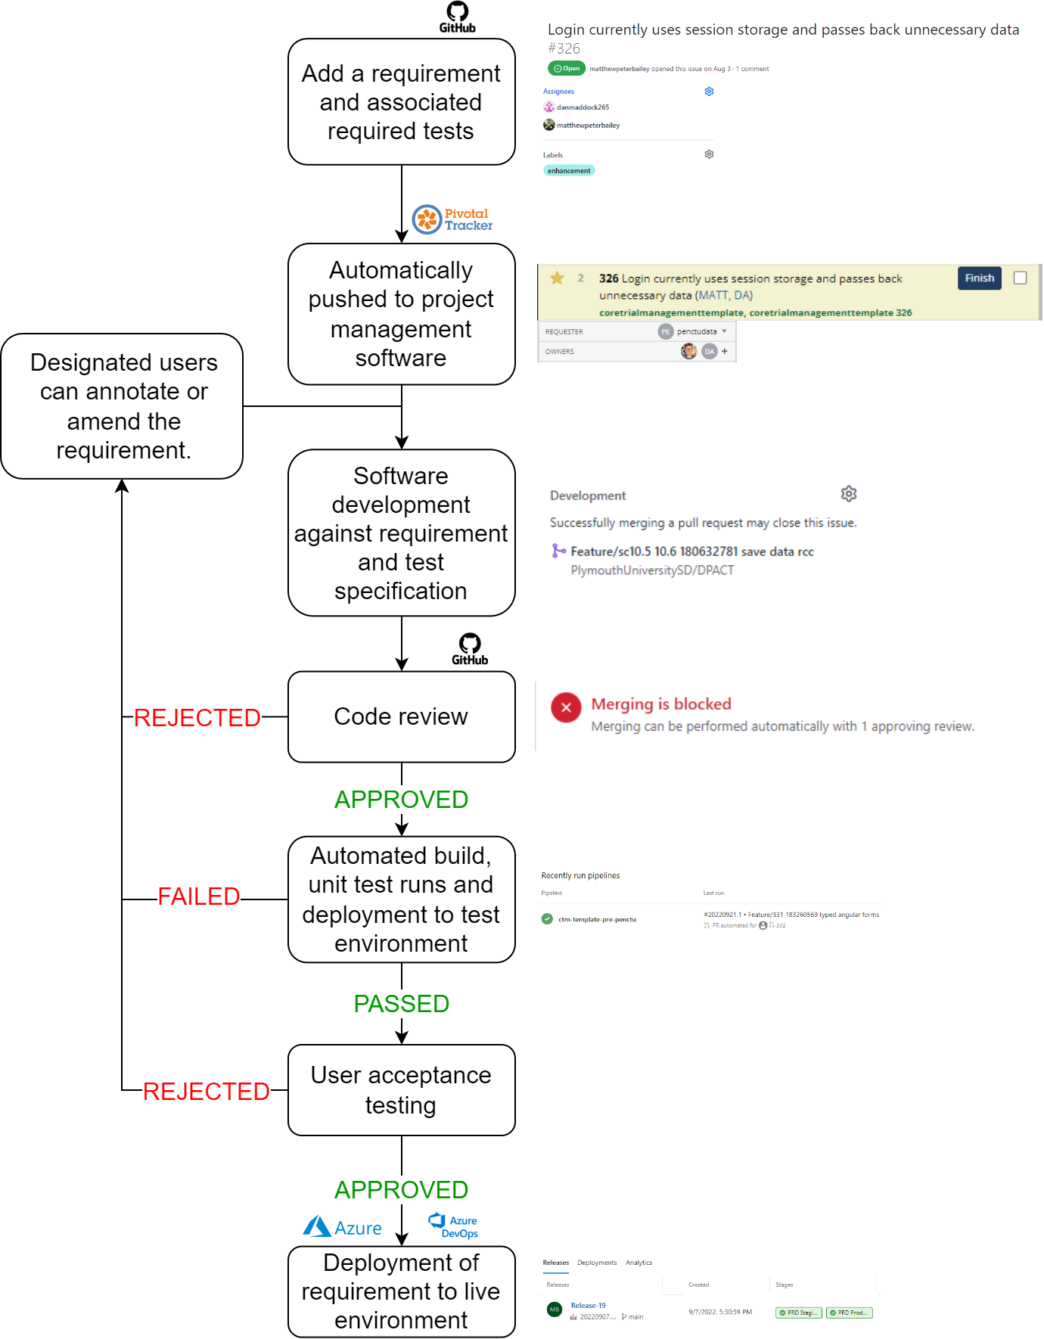

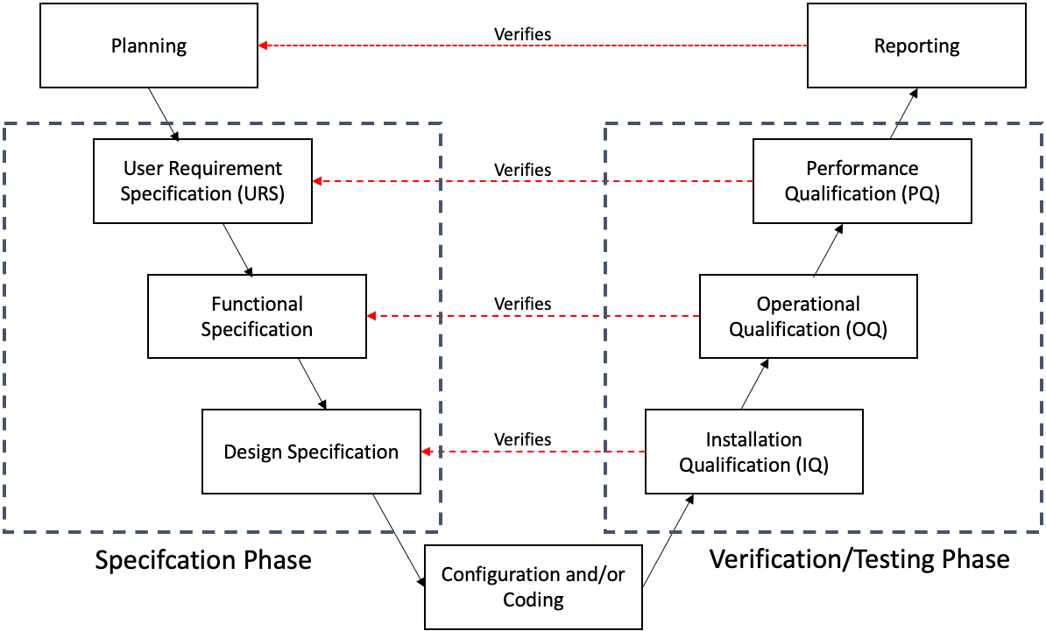








Matthew Bailey, Daniel Maddock, Ryan Ashford, Hanna Abraham, Chris Hayward
Peninsula Clinical Trials Unit (PenCTU), University of Plymouth
A paperless approach to clinical trial systems:
from specification to validation and beyond.
Introduction
A Paperless Approach
An important part of the development and testing of computer systems within clinical trials is Computer System Validation (CSV). This is the documentation and proof that a process, service, or product yields an expected result. Demonstrating suitably robust CSV is a fundamental requirement for academic CTUs working on regulated clinical trials.
Software development and deployment is an iterative process which requires involvement from many members of the team, working concurrently. To try to avoid the problems experienced with a paper-based approach, we use modern software development tools to create a streamlined, more automated, solution (Figure 2).
Figure 2: A summary of a paperless approach to bespoke CDMA development and the corresponding CSV.
Aim: To explore the advantages and disadvantages of a paperless approach to CSV for bespoke trial specific Clinical Data Management Applications (CDMAs).
Problems With Paper
The documentation that the information systems team needs to create and maintain a bespoke CDMA, as a minimum, includes:
Requirement specification documents
Testing checklists
Deployment and version logs
Change request logs
The files required to demonstrate the validity of a clinical trial eCRF system takes up a lot of space, cannot be managed remotely and may be required to be physically archived for up to 25 years.
Wet-ink signatures are required from various parties, for both approval and audit purposes. This reduces the speed of computer system development and requires the original document to be produced during an audit/regulatory inspection.
The waterfall methodology encourages linear progression of tasks within a project (Figure 1). Since each step requires a signature:
Development cannot begin until specification documents have been signed-off;
Testing cannot begin until all requirements have been built and signed-off;
Deployment cannot happen until testing documentation has been signed-off.
Figure 1: The waterfall approach to CSV.
Benefits
Many tangible improvements can be made when study systems and corresponding CSV are designed electronically.
Wastes less paper as specification and validation documentation is stored electronically.
Improves collaboration since all members of the team have the ability to make comments on requirements at any stage of development.
Increases traceability since all actions are user attributable and completed electronically behind a log in. Changes to code are linked to corresponding requirements.
Drives efficiency as requirements are electronically searchable and development processes are streamlined.
Tools We Use
Discussion
Version control software for managing changes to computer programs with additional features such as access control, bug tracking, software feature requests.
Project management software for managing and tracking workload across the information systems team.
Cloud computing environments for application management via provider-managed data centres.
Build and deployment pipelines for automated builds, testing and release management capabilities – otherwise known as Continuous Integration/Continuous Deployment (CI/CD).
Can a paperless approach to CSV further improve both quality and efficiency?
There are significant improvements using a paperless approach in terms of time-savings, enhanced collaboration and traceability.
Can a paperless approach to CSV satisfy the expectations of regulatory inspectors?
Visiting inspectors like to have the option of taking folders and files off-site to scrutinise during inspection. Further work is underway to consider how best to ensure that visiting inspectors have the ability to access, navigate and interrogate the various systems, so that they can assess the CSV processes.
Peninsula Clinical Trials Unit
plymouth.ac.uk/penctu
@Pen_CTU

